Slide 1

Educational Institutions and Courses Analytics Report
By: Justice Kofi Annan Ekuban
09/07/2025

Slide 2
Executive Summary
Overview:
Analyze the distribution of colleges, course types, and durations.
Identify top institutions and popular course categories.
Key Metrics:
Total Colleges: 15K
Unique Courses: 1K
Professional Courses: 18%
Average Course Duration: 21 months

Slide 3
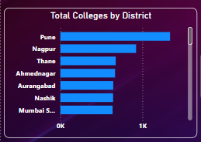
Total Colleges by District
Interpretation:
Pune has the highest concentration (1.3K)
Followed by Nagpur, Thane, etc.

Slide 4
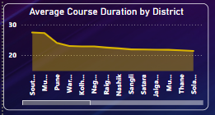
Course Duration Analysis
Interpretation:
Districts like Solapur and Pune have higher average durations.
Factors may include type of programs offered (e.g., PG, PhD)

Slide 5
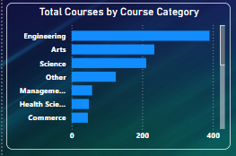
Course Distribution by Category
Interpretation:
Engineering dominates (390)
Followed by Arts and Science.
Suggests emphasis on technical education.

Slide 6
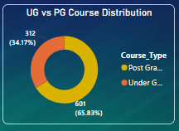
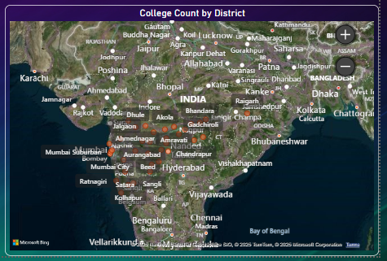
College Distribution Insights
Hightlight:
Majority are PG courses (65.8%)
Concentration in specific regions

Slide 7
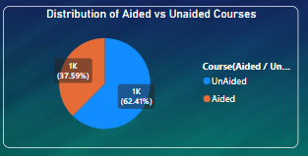
Aided vs Unaided Analysis
Insights:
62.41% of courses are unaided Professional
Courses are more common in unaided colleges

Slide 8
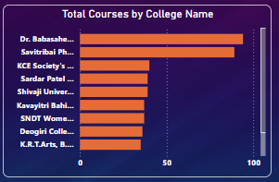
Top Performing Colleges
Highlights:
Dr. Babasaheb Ambedkar Marathwada University leads in course variety.
Could be a hub for diverse education.

Slide 9
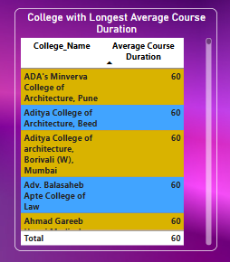
Average Duration by College
Insights:
Several colleges have programs averaging 60 months.
Likely PhD or dual-degree institutions

Slide 10
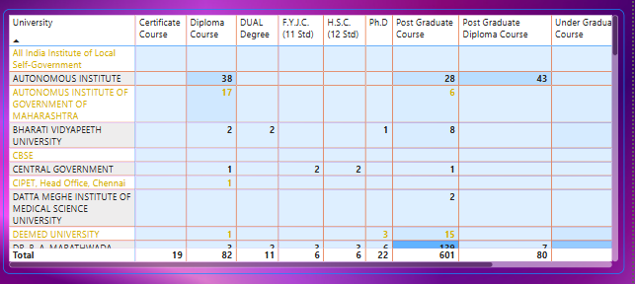
University-wise Course Distribution
Findings:
Universities like CBSE and Autonomous Institutes offer varied course types.
Notable contributions to PG and diploma programs.

Slide 11
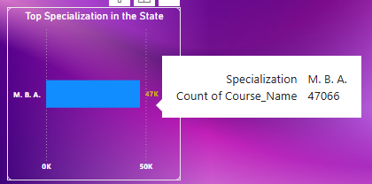
Specialization Trends
Findings:
MBA is the most popular specialization (47K courses)
Emphasizes focus on business education

Slide 12
Conclusion & Recommendations
Summary:
Engineering, MBA, and Arts are dominant fields.
Pune is a key education hub.
UG courses dominate at 65.8%.
Recommendations:
Expand access to professional courses.
Invest in underrepresented districts.
Balance aided and unaided programs.

Slide 13
Thank you
Justice Kofi Annan Ekuban
justiceekuban2004@gmail.com

